Slide 1





IETF 99 Hackathon
SDN Applications for microwave radio link via IETF YANG Data Model

Slide 2



YANG model for Microwave radio link
The framework draft (draft-ietf-ccamp-microwave-framework) was adopted by CCAMP WG:
https://datatracker.ietf.org/doc/draft-ietf-ccamp-microwave-framework/
The YANG model draft (draft-ietf-ccamp-mw-yang) was adopted by CCAMP WG: https://datatracker.ietf.org/doc/draft-ietf-ccamp-mw-yang/
December, 2016
April, 2017
June, 2016
March, 2017
July, 2017
A design team was set up in IETF CCAMP WG to work on microwave radio links Yang Modeling
“Microwave Modelling at CCAMP WG”in IETF journal:
https://www.ietfjournal.org/working-group-update-microwave-modelling-at-ccamp/
Hackathon in IETF 99 to validate the microwave model

Slide 3
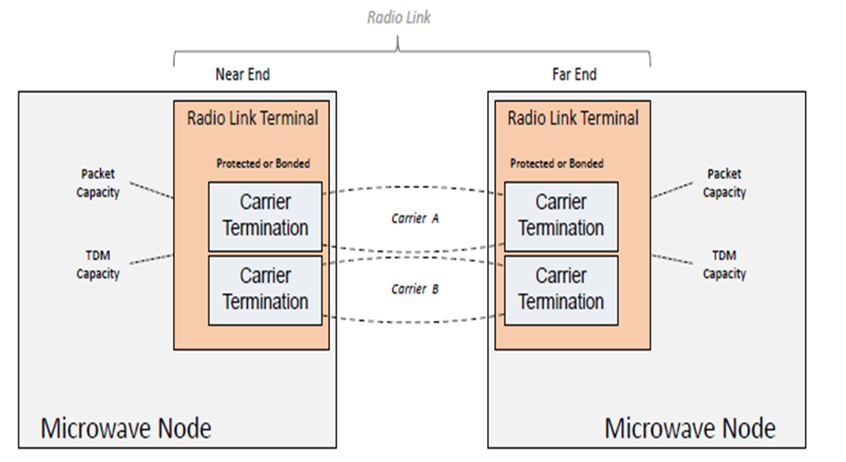
What was developed in hackathon
Purpose: To validate the model defined in draft-ietf-ccamp-mw-yang-01
Developed in hackathon:
MW YANG model in ODL controller
Two applications: Energy Efficiency and Dynamic frequency control
App 1: Energy efficiency
to save power consumption when traffic is low
Day Time
App 1:
Energy efficiency
App 2:
Dynamic frequency control
Traffic
Night Time
Power consumption
Peak time
Off-peak time
MW YANG
model
With energy efficiency
SDN controller – ODL based
draft-ietf-ccamp-mw-yang
App 2: Dynamic frequency control
to control the interference
！
Low SNIR
SNIR
f1
Alert threshold
f2
Frequency
f1
f2

Slide 4
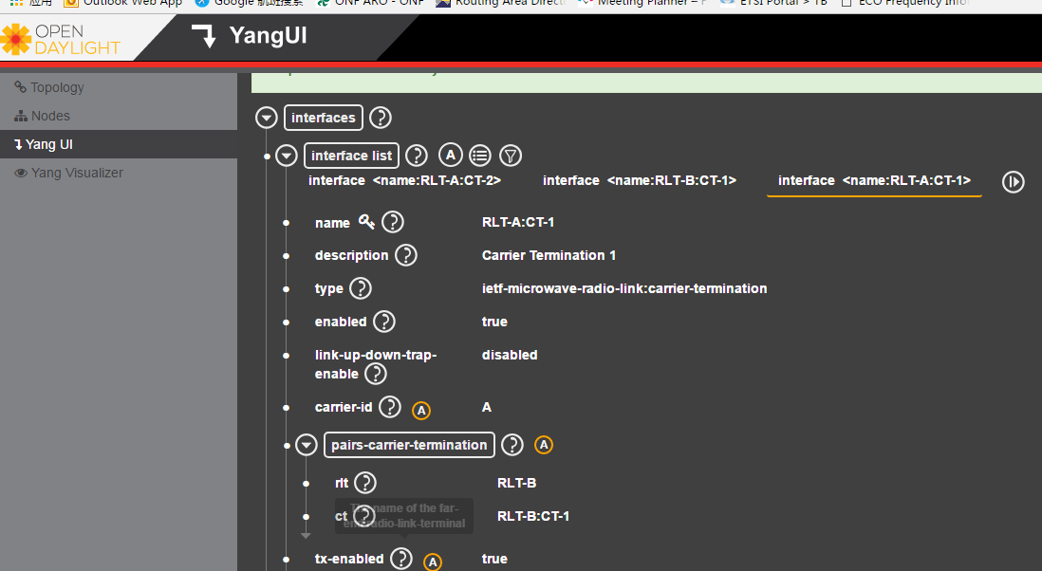
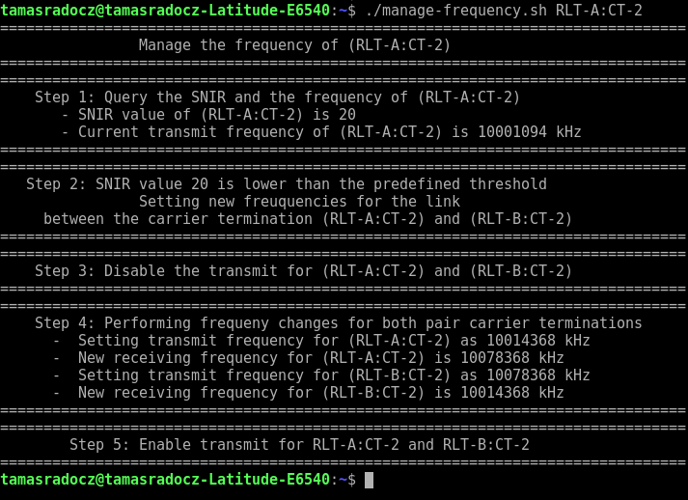
Achievement & Next step
Achievement:
Added implementation of IETF mw YANG model in open source software (ODL)
Validated the mw YANG data model, and developed & tested the two use case applications successfully
Bring industry vendor competitors and university to work together
Attracted three first IETFers
Lesson learned:
Need to optimize the way of rx-frequency configuration
Require additional statistics e.g. link utilization information
Use of REST APIs instead of RESTCONF
Next step:
Cooperate with other packet interfaces e.g. Ethernet
Add more statistics either in mw YANG model, or in an ETH YANG model
If possible, contribute the model implementation to open source project

Slide 5
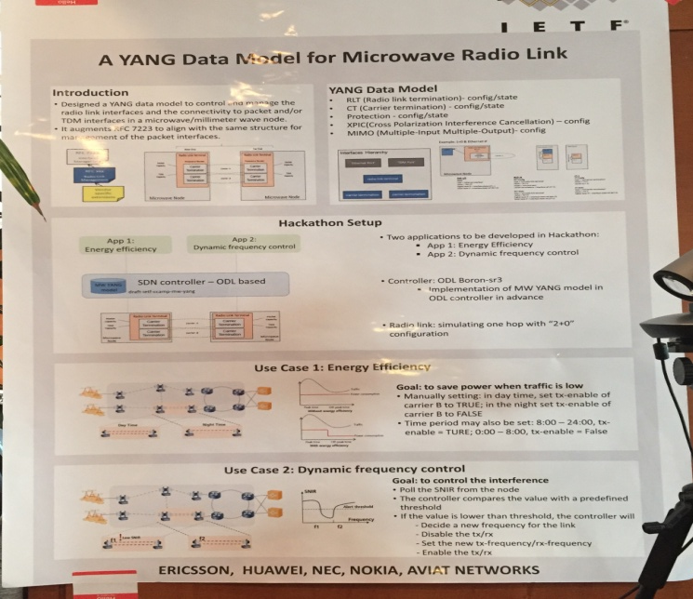
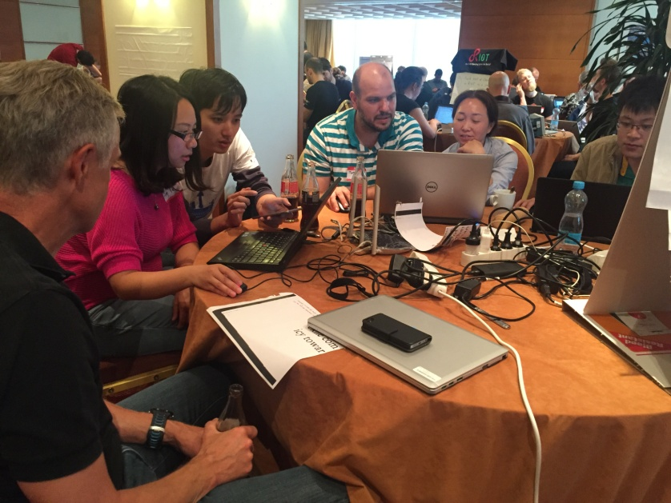
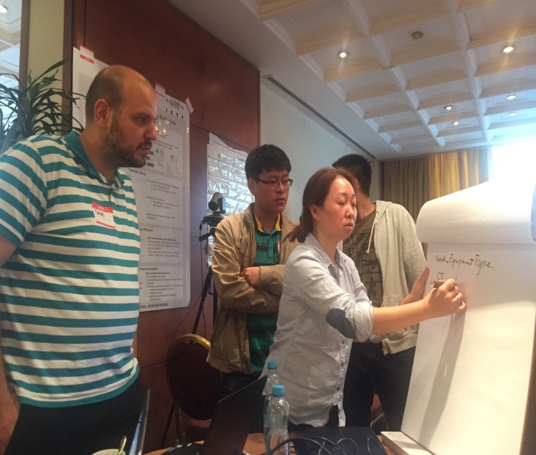
Thanks for the team!
Team members:
On site: Min Ye, Jinchao Pang, Jonas Ahlberg, Tamas Radocz, Xi Li, Haomian Zheng, Zheyu Fan, Carlos J. Bernardos
Remote: Koji Kawada, Daniela Spreafico, Marko Vaupotic

